Slide 1
Analysis of Algorithms
SY Computer
Even 2022-23

Slide 2
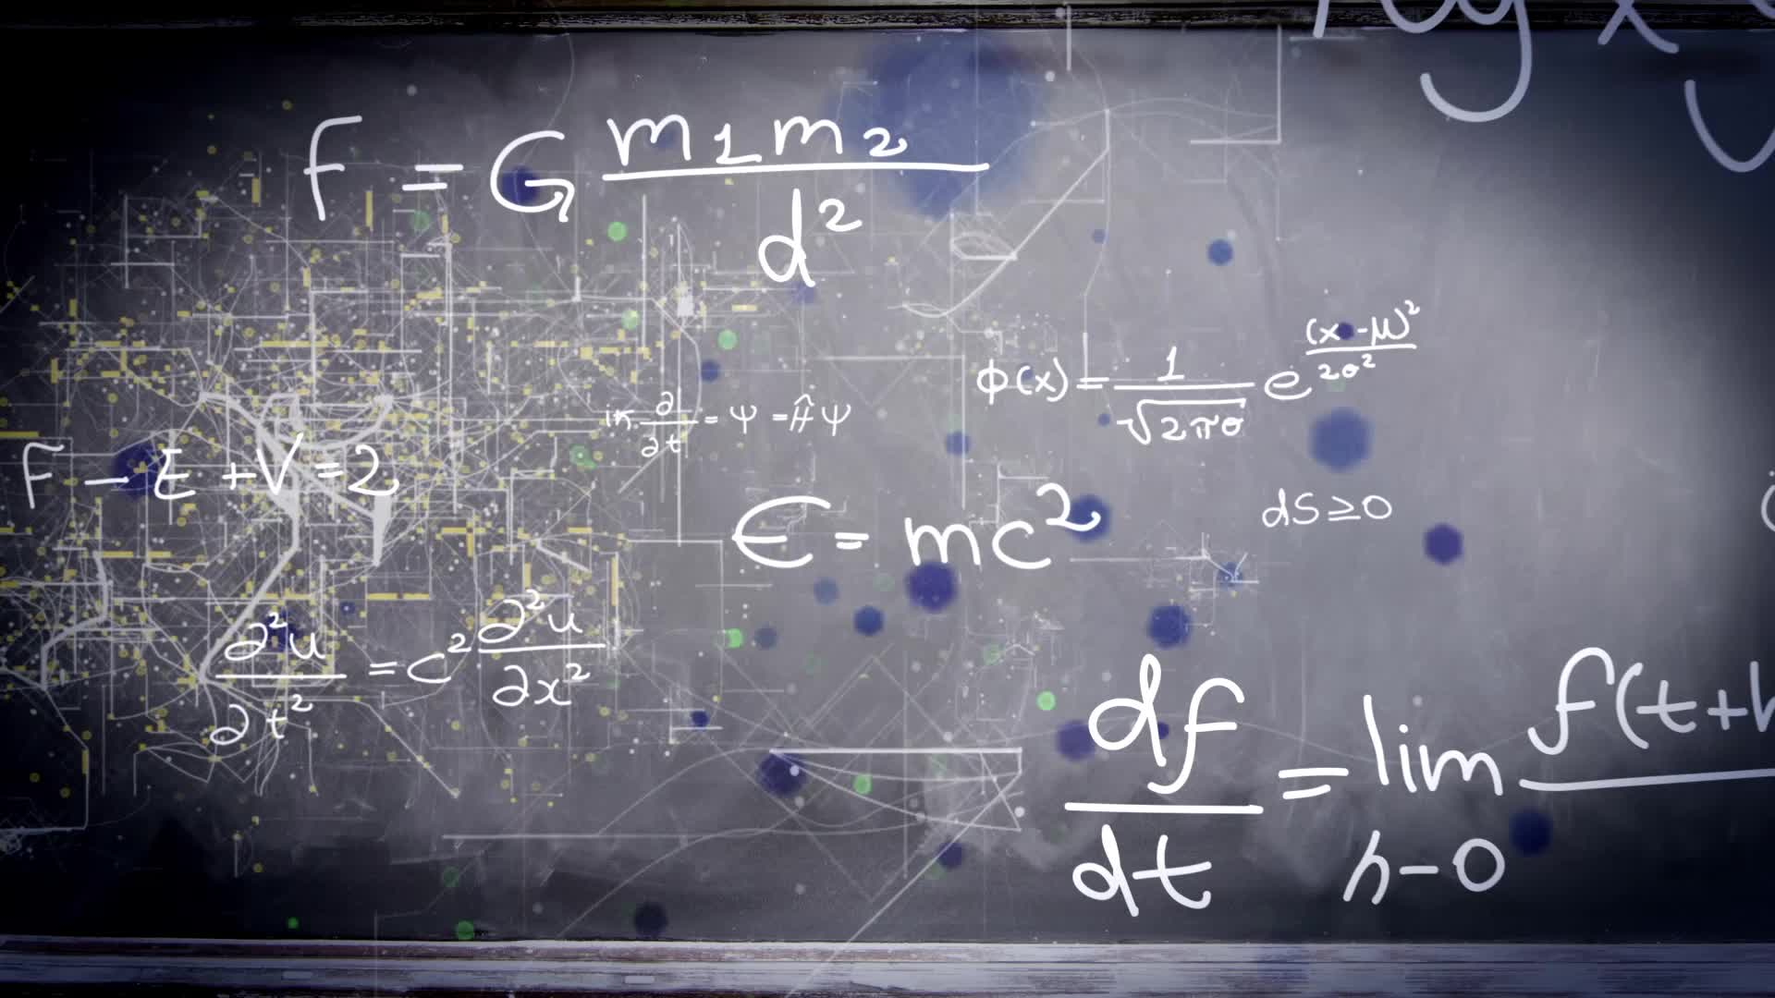
Introduction
Algorithm:
An Algorithm is a finite sequence of instructions, each of which has a clear meaning and can be performed with a finite amount of effort in a finite length of time.
**We represent algorithm using a pseudo language that is a combination of the constructs of a programming language together with informal English statements.

Slide 3
Every algorithm must satisfy the following criteria:
Input: there are zero or more quantities, which are externally supplied;
Output: at least one quantity is produced
Definiteness: each instruction must be clear and unambiguous;
Finiteness: if we trace out the instructions of an algorithm, then for all cases the algorithm will terminate after a finite number of steps;
Effectiveness: every instruction must be sufficiently basic that it can in principle be carried out by a person using only pencil and paper. It is not enough that each operation be definite, but it must also be feasible.

Slide 4
Performance Analysis
The performance of a program is the amount of computer memory and time needed to run a program.
Time Complexity
Space Complexity
How to compare Algorithms?
Execution time
Number of statements executed
Running time Analysis

Slide 5
Time Complexity
The time needed by an algorithm expressed as a function of the size of a problem is called the time complexity of the algorithm.
The time complexity of a program is the amount of computer time it needs to run to completion.
Time Complexity is mainly of 3 Types:
Best Case
Worst Case
Average Case

Slide 6
Space Complexity
The space complexity of a program is the amount of memory it needs to run to completion. The space need by a program has the following components:
Instruction space: Instruction space is the space needed to store the compiled version of the program instructions.
Data space: Data space is the space needed to store all constant and variable values.
Environment stack space: used to save information needed to resume execution of partially completed functions.
The space requirement S(P) of any algorithm P may therefore be written as,
S(P) = c+ S_{p}(Instance characteristics)
where “c” is a constant.

Slide 7
Complexity of Algorithms
The complexity of an algorithm M is the function f(n) which gives the running time and/or storage space requirement of the algorithm in terms of the size “n” of the input data.
Approaches to calculate Time/Space Complexity:
Frequency count/Step count Method
Asymptotic Notations – (Order of)

Slide 8
Frequency count/Step count Method
Rules:
For comments, declaration
count = 0
return and assignment statement
count = 1
Ignore lower order exponents when higher order exponents are present
Ex. Complexity of following algo is as follows:
f(n) = 6n³ + 10n² + 15n + 3 ⟹ 6n³
Ignore constant multipliers
6n³ ⟹ n³
f(n) = O(n³)

Slide 9
Example 1:sum of n values of an array
Time Complexity
→ 1
→ n+1
→ n
1
2n+3 f(n) = O(n)
Space Complexity
a[] = n words
n= 1 word
s= 1 word
i= 1 word
n+3 Space complexity = O(n)
Algorithm sum (int a[], int n
s = 0;
for(i=0; i<n; i++)
{
s=s + a[i];
}
return s;

Slide 10
Example 2:Addition of two square Matrices of dimension n×n
Time Complexity
→ n+1
→ n×(n+1)
→ n×n
n+1+n²+n +n² 2n² + 2n +1 f(n) = O(n² )
Space Complexity
a[][] = n² words
b[][] = n² words
c[][] = n² words
i= 1 word
j= 1 word
n= 1 word
→ 3n² +3 Space complexity = O(n² )
Algorithm addMat (int a[][], int b[][])
{ int c[][];
for(i=0; i<n; i++) {
for(j=0; j<n; j++) {
c[i][j] = a[i][j] + b[i][j]
}
}
}

Slide 11
Example 3:Multiplication of two Matrices of dimension n×n
Time Complexity
→ n+1
→ n×(n+1)
→ n×n
→ n×n×(n+1)
n×n×n
n+1+n²+n +n² +n³ +1+ n³ +n² 2n³ +3n² + 2n +1 f(n) = O(n³ )
Space Complexity
a[][] = n² words
b[][] = n² words
c[][] = n² words
i= 1 word
j= 1 word
k=1 word
n= 1 word
→ 3n² +4 Space complexity = O(n² )
Algorithm matMul (int a[][], int b[][])
{ int c[][];
for(i=0; i<n; i++) {
for(j=0; j<n; j++) {
c[i][j] = 0;
for(k=0; k<n; k++){
c[i][j] = a[i][j] * b[i][j]
}
}
}
}

Slide 12
Example: loops
1.
Time Complexity
→ n+1
→ n
f(n) = 2n+1 f(n) = O(n )
for(i=0; i<n; i++) {
statements;
}
2.
Time Complexity
→ n+1
→ n
f(n) = 2n+1 f(n) = O(n )
for(i=n; i>n; i--) {
statements;
}

Slide 13
Example: loops
3.
Time Complexity
→ n+1
→ n/2
f(n) = 3n/2+1 f(n) = O(n )
for(i=1; i<n; i=i+2) {
statements;
}
4.
Time Complexity
→ n+1
n(n+1)
→n×n
f(n) = 2n²+2n+1 f(n) = O(n²)
for(i=0; i<n; i++) {
for(j=0; j<n; j++) {
statements;
}
}

Slide 14
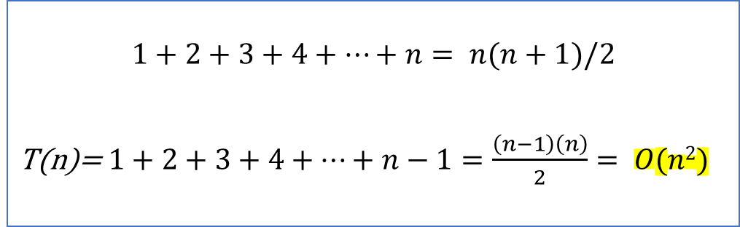
Example: loops (By tracing)
Time Complexity
i | j | statements
0 | 0 | 0
1 | 0 | 1
 | 1
2 | 0 | 2
 | 1
 | 2
3 | 0 | 3
 | 1
 | 2
 | 3
… | … | …
N | 0 to n-1 | n
5.
for(i=0; i<n; i++) {
for(j=0; j<i; j++) {
statements;
}
}
$$1+2+3+4+…+n= n(n+1)/2$$
T(n)= $1+2+3+4+…+n−1=\frac{\left(n−1\right)\left(n\right)}{2}= O(n2)$

Slide 15
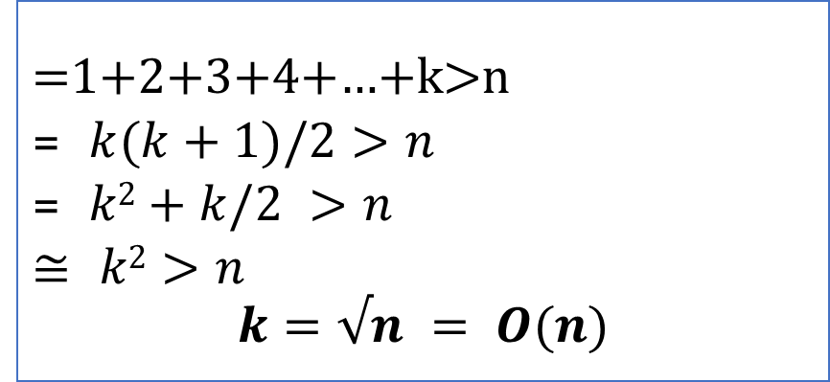
Example 5: loops (By tracing)
Time Complexity
i | p | statements
1 | 0+1 | 1
2 | 1+2 | 1
3 | 1+2+3 | 1
4 | 1+2+3+4 | 1
5 | 1+2+3+4+5 | 1
6 | 1+2+3+4+5+6 | 1
k | 1+2+3+4+…+k | ???
6.
p=0 ;
for(i=1; p<=n; i++) {
p=p+i;
}
}
=1+2+3+4+…+k>n
= $k(k+1)/2>n$
= $k2+k/2 >n$
≅ $k2>n$
$$k=√n = O(n)$$

Slide 16
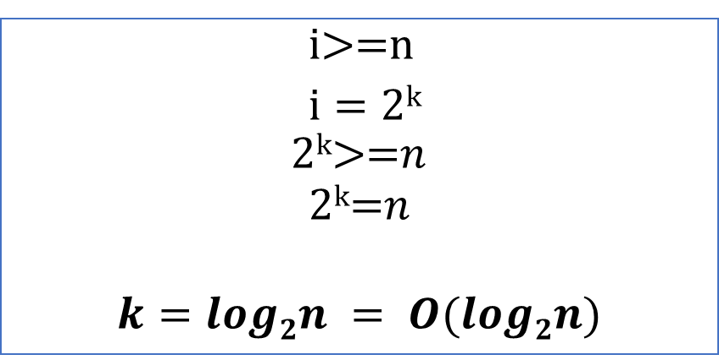
Example: loops (By tracing)
6.
Time Complexity
i | statements
1*2⁰ | 1
1*2 | 1
1*2*2 | 1
1*2*2*2 | 1
… | …
… | …
2^{k} | ¹
for(i=1; i<n; i=i*2) {
statements;
}
}
i>=n
$i=\text{2}\text{k}$
$$\text{2}\text{k}\text{>=}n$$
$$\text{2}\text{k}\text{=}n$$
$$k=log2n = O(log2n)$$

Slide 17
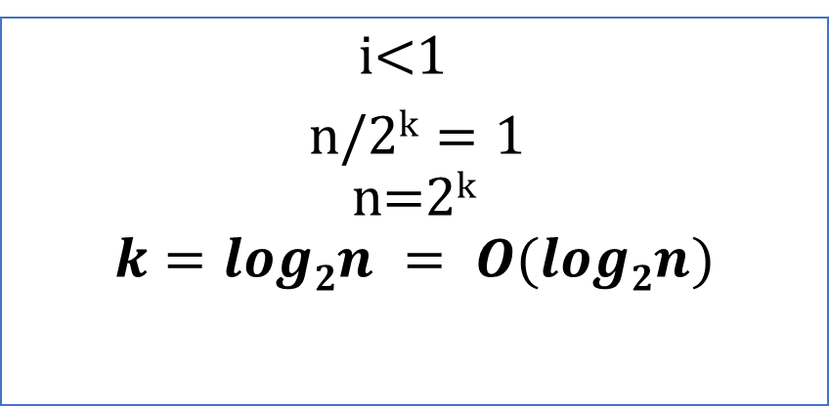
Example: loops (By tracing)
7.
for(i=n; i>=1; i=i/2) {
statements;
}
}
Time Complexity
i
n
n/2
n/2²
n/2³
n/2⁴
…
n/2^{k}
i<1
$\text{n}\text{/2}\text{k}=\text{1}$
$$\text{n}\text{=}\text{2}\text{k}$$
$$k=log2n = O(log2n)$$

Slide 18
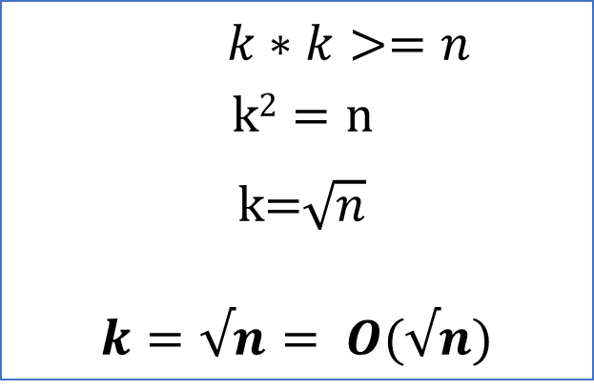
Example: loops (By tracing)
8.
for(i=0; i*i<n; i++) {
statements;
}
}
Time Complexity
i | statements
1 | 1
2 | 2²
3 | 3²
4 | 4²
5 | 5²
… | …
k | k²
$k∗k>=n$
$$k2=\text{n}$$
$\text{k}\text{=}\sqrt{n}$
$$k=√n= O(√n)$$

Slide 19
Example: loops (By tracing)
9.
for(i=1; i<n; i=i*2) {
p++;
} for(j=1;j<p;j=j*2){ statements;
}
p = log₂n
T(n) = log₂p
T(n) = log₂ log₂n

Slide 20
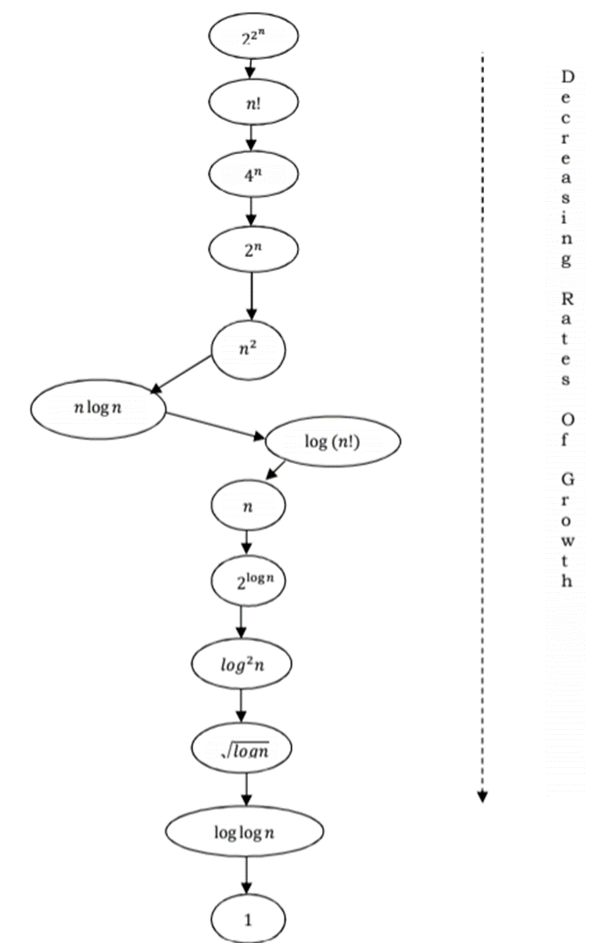
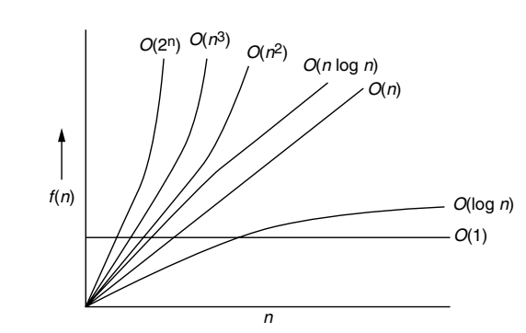

Rate of Growth
Rate at which the running time increases as a function of input is called Rate of Growth.
Example:
$$n4+2n2+100n+500≈n4$$
$n4 ,2n2,100n and 500 are individual$
$$cost of some functions and approximate$$
$$to n4 since n4 is highest rate of growth.$$

Slide 21
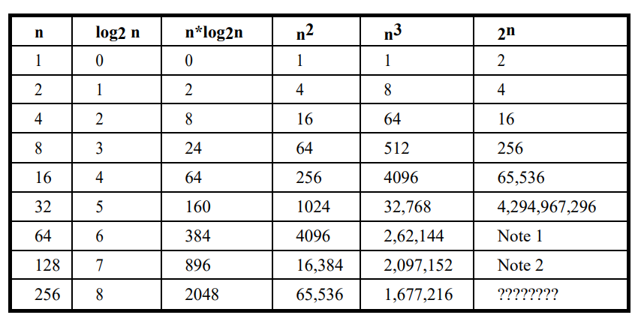
Numerical Comparison of Different Algorithms

Slide 22
Asymptotic Notations:
Asymptotic notations have been developed for analysis of algorithms.
By the word asymptotic means “for large values of n”
The following notations are commonly use notations in performance analysis and used to characterize the complexity of an algorithm:
Big–OH(O)
Big–OMEGA(Ω),
Big–THETA (Θ)

Slide 23
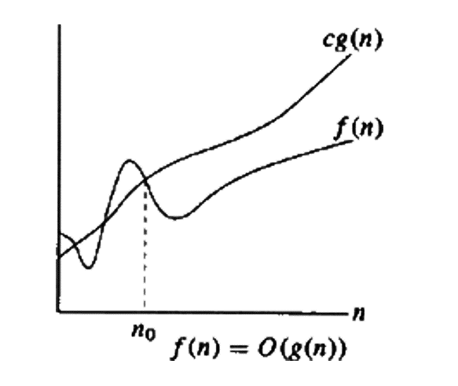

Big O notation:
This notation gives the tight upper bound of the given function
Represented as:
$$f(n) = O(g(n))$$
that means, at larger values of n, upper bound of f(n) is $g(n)$.
Definition:
Big O notation defined as O($g(n)$) = $\{f(n):$there exist positive constants c and no such that
$$0<= f\left(n\right)<=c.g\left(n\right)for all n>n0\}$$

Slide 24
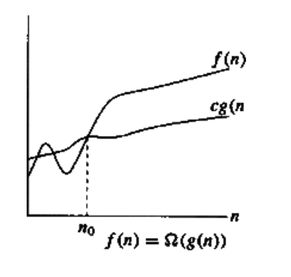

Big Omega (Ω) notation:
This notation gives the tight lower bound of the given function
Represented as:
$$f(n) =Ω(g(n))$$
that means, at larger values of n, lower bound of $f(n)$ is $g(n)$.
Definition:
Big $Ω$ notation defined as $Ω$($g(n)$) = $\{f(n):$there exist positive constants c and no such that
$$0<=c.g\left(n\right)≤=f\left(n\right) for all n>n0\}$$

Slide 25
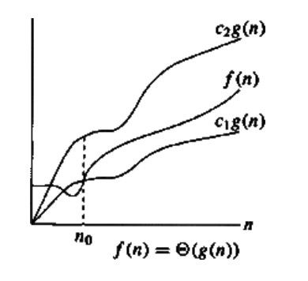

Big Theta (θ) Notation:
Average running time of an algorithm is always between lower bound and upper Bound
Represented as:
$$f(n) =\text{θ}(g(n))$$
that means, at larger values of n, lower bound of $f(n)$ is $g(n)$.
Definition:
Bigθ notation defined as θ($g(n)$) = $\{f(n):$there exist positive constants c₁ and c₂ and n_{o} such that $0≤c1.g\left(n\right)≤f\left(n\right)≤c1.g\left(n\right)$
$$for all n>n0\}$$

Slide 26

Properties of Asymptotic Notations:
Examples:
--------------
f(n) = n & g(n) = n² & h(n)=n³
n = O(n²) ; n2=O(n³),
then n = O(n³)
------------------------------------------------------------
2. f(n) = n³ = O(n³) = θ(n³) = Ω(n³)
------------------------------------------------------------
3. f(n) = n² & g(n) = n²
then, f(n) = θ(n²)
------------------------------------------------------------
4. f(n) = n & g(n) = θ(n²)
then n = O(n²) & n²= Ω(n)
Transitivity:
$f(n) = θ(g(n))$ & $g(n) = θ(h(n))$
➔ $f(n) = θ(h(n))$
Valid for O and Ω as well.
Reflexivity:
$f(n) = θ(f(n))$
Valid for O and Ω as well.
Symmetry:
$f(n) = θ(g(n))$ , iff $g(n)= θ(f(n))$
Transpose Symmetry:
$f\left(n\right)= θ\left(g\left(n\right)\right) iff g(n)= Ω(f(n))$

Slide 27

Properties of Asymptotic Notations:
Observations:
If $f(n) = O(kg(n))$for any constant k>0, then f(n) = O(g(n))
If f₁(n) = O(g₁(n)) and f₂(n) = O(g₂(n)), then (f₁+ f₂)(n) = O(max(g₁(n), g₂(n))
If f₁(n) = O(g₁(n)) and f₂(n) = O(g₂(n)), then f₁(n) f₂(n) = O(g₁(n). g₂(n))
If f(n) = O(g(n)) and f(n) = Ω(g(n)), then f(n) = θ(g(n))

Slide 28
Recursion:
Recursion is an ability of an algorithm to repeatedly call itself until a certain condition is met.
Such condition is called the base condition.
The algorithm which calls itself is called a recursive algorithm.
The recursive algorithms must satisfy the following two conditions:
It must have the base case: The value of which algorithm does not call itself and can be evaluated without recursion.
Each recursive call must be to a case that eventually leads toward a base case.

Slide 29
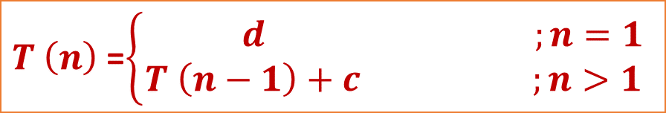

Recursion:
Recurrence Relation:
An algorithm is said to be recursive if it can be defined in terms of itself.
The running time of recursive algorithm is expressed by means of recurrence relations.
A recurrence relation is an equation of inequality that describes a function in terms of its value on smaller inputs.
It is generally denoted by $T(n)$ where $n$ is the size of the input data of the problem.
The recurrence relation satisfies both the conditions of recursion, that is, it has both the base case as well as the recursive case.
The portion of the recurrence relation that does not contain $T$ is called the base case of the recurrence relation and
The portion of the recurrence relation that contains $T$ is called the recursive case of the recurrence relation.
$T \left(n\right)$ =$\left\{\begin{aligned} d ;n=1 \\ T \left(n−1\right)+c ;n>1\end{aligned}\right.$

Slide 30

Example: Factorial
$$n = n∗(n−1)∗(n−2)∗(n−3)∗…3∗2∗1$$
$$n = n∗(n−1)$$
$\left(n−1\right)!=(n−1)∗(n−2)$ $$
$\left(n−2\right)!=(n−2)∗(n−3)$ $$
…
…
$$3  = 3∗2 $$
$$2  = 2∗1 $$
$$1  = 1∗0  = 1∗1 = 1$$
5!
5*4!
2*1!
3*2!
4*3!
1*0!
0!=1
Base Condition

Slide 31
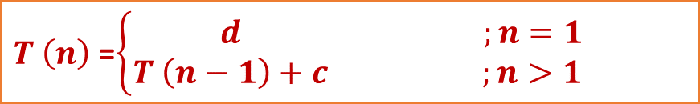
Factorial Algorithm:
Recursive Method:
Iterative Method:
Algorithm fact(n)
If (n<0) then return(“error”);
else
If (n<2) then return(1);
else
Return (n*fact(n-1);
End if
End if
End fact
Algorithm fact(n)
If (n<0) then return(“error”);
else
If (n<2) then return(1);
else
prod=1;
End if
End if
For(i=n down to 0)
do prod=prod*i
end for
Return prod
End fact
$T \left(n\right)$ =$\left\{\begin{aligned} d ;n=1 \\ T \left(n−1\right)+c ;n>1\end{aligned}\right.$

Slide 32
Recursion:
Recurrence Relation:
There are various methods to solve recurrence:
Iterative Method / Substitution Method
Recurrence Tree
Master Method/ Master’s Theorem

Slide 33
Recursion:
Recurrence Relation:
There are various methods to solve recurrence:
Iterative Method / Substitution Method
Recurrence Tree
Master Method/ Master’s Theorem

Slide 34
Recursion:
Recurrence Relation:
There are various methods to solve recurrence:
Iterative Method / Substitution Method
Recurrence Tree
Master Method/ Master’s Theorem

Slide 35
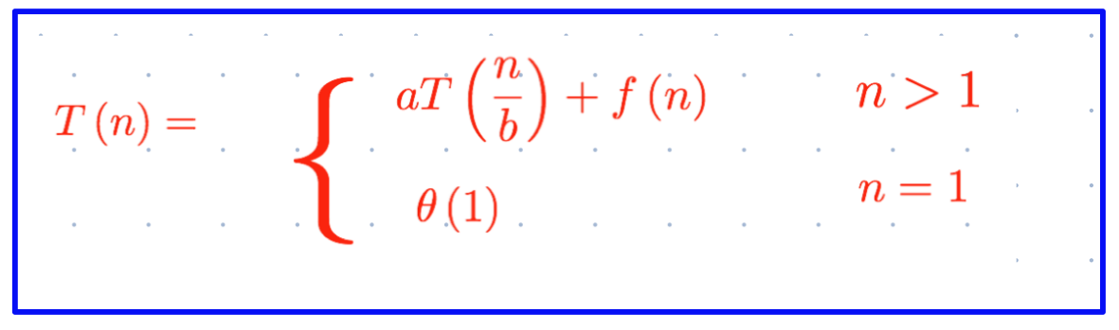
Recursion:
Master’s Theorem:
Dividing Functions
Decreasing Functions
Dividing functions:
Master’s method (for Dividing Functions) provides general method for solving recurrences of the form:

Slide 36
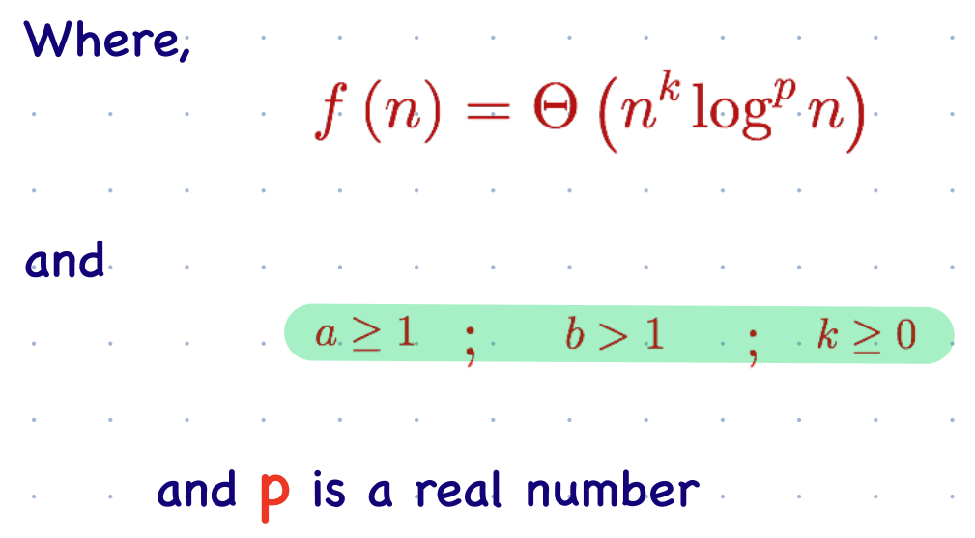
Recursion:
1. Dividing functions:
Master’s method (for Dividing Functions) provides general method for solving recurrences of the form:

Slide 37
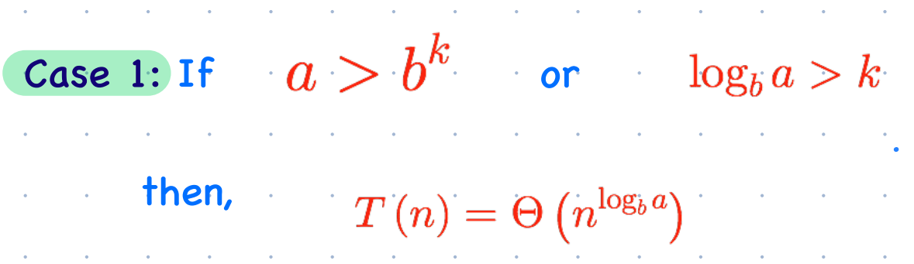
Recursion:
1. Dividing functions:
Master’s method (for Dividing Functions) provides general method for solving recurrences of the form:

Slide 38
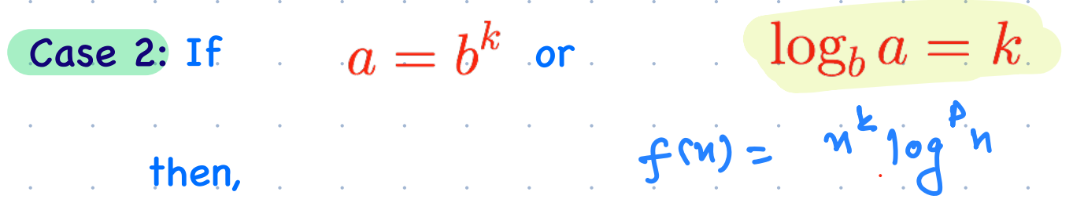
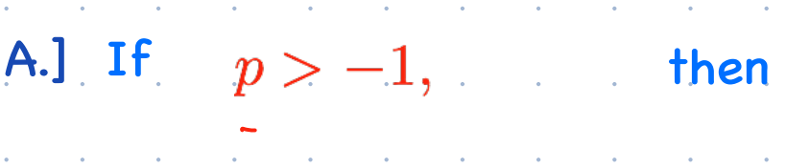
Recursion:
1. Dividing functions:
Master’s method (for Dividing Functions) provides general method for solving recurrences of the form:

Slide 39
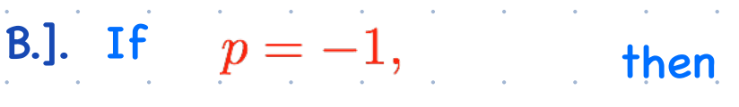
Recursion:
1. Dividing functions:
Master’s method (for Dividing Functions) provides general method for solving recurrences of the form:

Slide 40
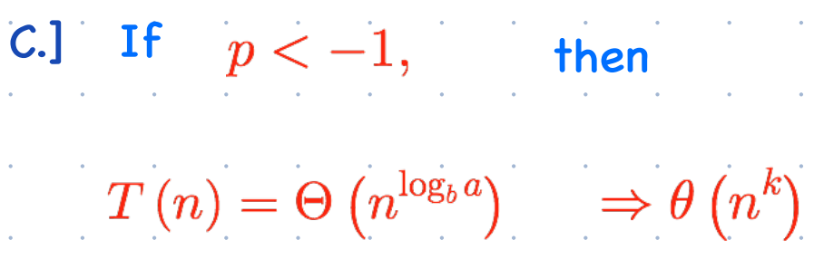
Recursion:
1. Dividing functions:
Master’s method (for Dividing Functions) provides general method for solving recurrences of the form:

Slide 41
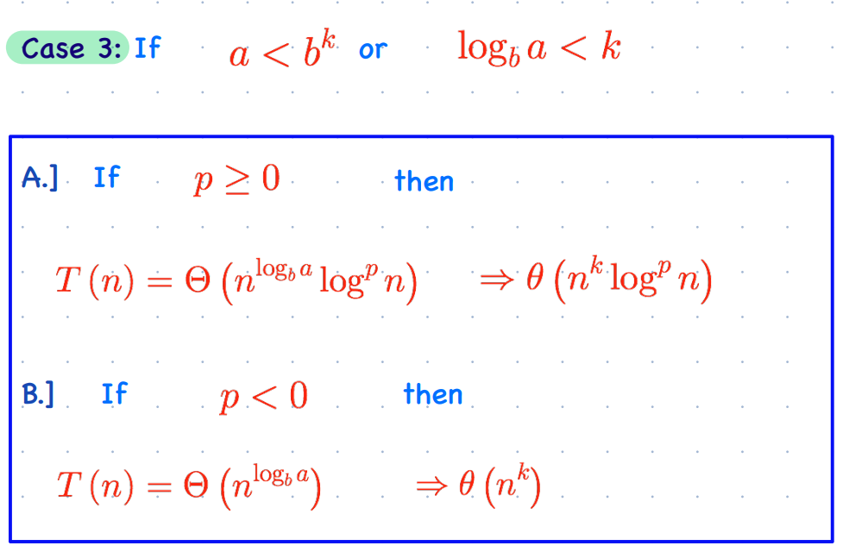
Recursion:
1. Dividing functions:
Master’s method (for Dividing Functions) provides general method for solving recurrences of the form:

Slide 42

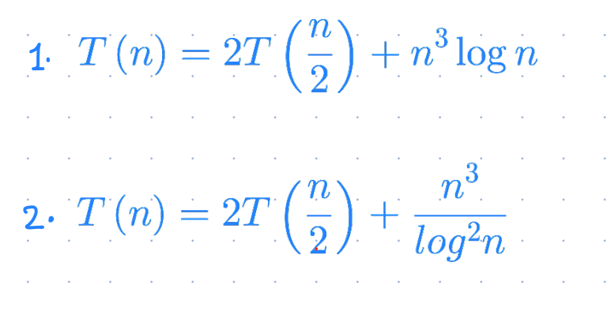
Master’s Theorem:
1.
Exercise:

Slide 43
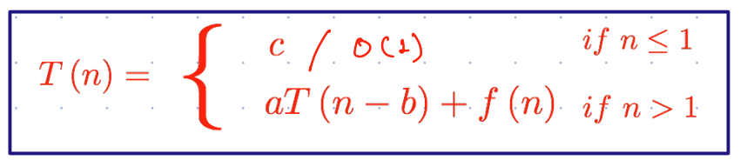
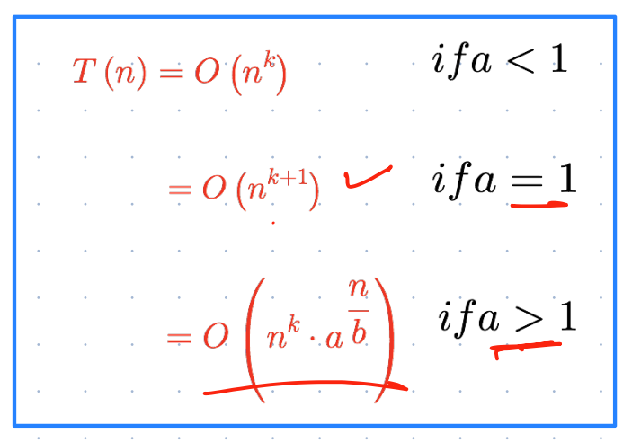



Master’s Theorem (for Decreasing Function)
Let T(n) be a function defined on positive n
for some constants c, a>0, b>0, k
where , then

